Slide 1
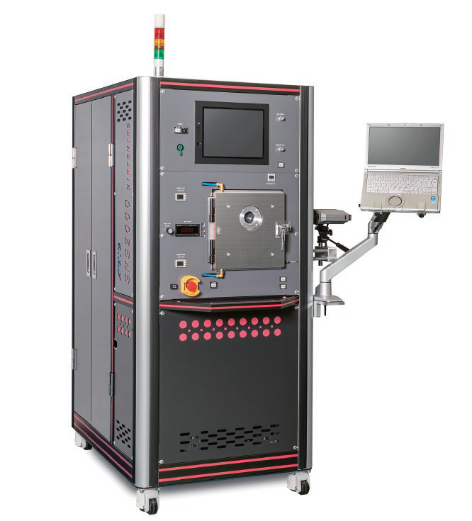
Features of SPS 2000
■Super Small Foot Print (about a half in conventional products)
20 – 70kN / 1000 – 3000A
■User friendly spacious chamber
■Electrode flow rate & water temp are digitally displayed. ■Built-in LED to check the status inside of vacuum chamber ■Super effective High Vacuum system / Option
■Capability for “FLASH SINTERING”

Slide 2
SPS2000 Specifications

